Slide 1
FINAL YEAR PROJECT (FYP) PRESENTATION
Emotion-Aware Interaction Using Facial Expression
and Sentiment Analysis
An End-to-End Multimodal Affective Perception Architecture Fusing Deep Facial Features, Multi-Corpus Vocal Acoustics & Transformer Language Sentiment for Empathetic Human-Machine Systems
PRESENTED BY:
Shahzaib Hussain (DCIS, PIEAS)
PROJECT SUPERVISORS:
• Dr. Ijaz Hussain — DCIS, Pakistan Institute of Engineering and Applied Sciences (PIEAS)
• Dr. Noman Mazhar — Islamabad Center for Cyber Security (ICCC)
Project Domain: Affective Computing | Multimodal Human-Robot Interaction (HRI) | Deep Learning & Transformers
Notes:
[Slide 1 - 0:00 to 0:45]
Good morning respected committee members and supervisors. My name is Shahzaib Hussain, and today I am presenting my Final Year Project entitled 'Emotion-Aware Interaction Using Facial Expression and Sentiment Analysis', supervised by Dr. Ijaz Hussain from PIEAS and Dr. Noman Mazhar from ICCC.
This research is situated at the intersection of Affective Computing and Human-Robot Interaction. Our goal is to empower intelligent systems to perceive human affective cues across visual, vocal, and textual modalities to foster genuine, context-aware empathy.

Slide 2
1. INTRODUCTION & CONTEXT
Background & Motivation: Why Emotion-Aware Interaction?
2/12
The Core Motivation: Emotional Blindness in AI
Real-World Relevance & Stakeholder Beneficiaries
• Emotional Intelligence as the Foundation of HRI:
Human communication is inherently multimodal: only 7% of emotional meaning is conveyed through pure lexical words, while 38% is transmitted via vocal acoustics and 55% via facial expressions (Mehrabian's Law).
• The Shift from Automation to Social Intelligence:
In Industry 5.0 and modern service robotics, machines must transcend rigid task execution to achieve empathetic collaboration, mutual trust, and emotional alignment with human partners.
• Multimodal Synergy:
Relying on a single modality is fundamentally fragile. A smiling face can mask sarcastic or distressed speech, while subdued speech may conceal subtle micro-expressions. Joint multimodal perception resolves emotional ambiguity.
1. Assistive Healthcare & Elder Care:
Social companion robots (e.g., NAO, Pepper) monitoring mood transitions, mitigating loneliness, and detecting depressive or anxious states in clinical/home settings.
2. Affective Education & Intelligent Tutoring:
Educational robots dynamically adjusting curriculum pace and pedagogy upon detecting learner confusion, frustration, or disengagement.
3. High-Stress Human-Robot Collaboration (HRC):
Detecting operator fatigue and cognitive overload in smart industrial workstations to pre-empt accidents and enhance safety.
4. Empathetic Conversational Systems:
Next-generation customer service and crisis support chatbots that adjust tone and response empathy based on real-time user sentiment.
Notes:
[Slide 2 - 0:45 to 1:35]
To understand the background of our work: traditional human-computer interaction is largely emotionally blind. While machines can recognize words and detect faces, they typically fail to grasp affective intent.
Psychological studies show that more than 90% of affective nuances are communicated through nonverbal channels—specifically facial gestures and vocal prosody.
In critical sectors such as eldercare, assistive robotics, and digital education, machines cannot be truly effective companions if they ignore distress, frustration, or sadness. Our motivation is to develop an AI perception stack that listens to acoustic subtleties, observes facial expressions, and analyzes sentiment to enable context-sensitive, empathetic interaction.

Slide 3
2. PROBLEM DEFINITION
Problem Statement: The Fragility of Current Affective Systems
3/12
Specific Problem Definition & Empirical Evidence
THE PROBLEM: Existing affective computing systems exhibit catastrophic performance drops when transitioning from controlled laboratory benchmarks to unconstrained, real-world interactions.
1. Severe Lab-to-Real-World Degradation Gap:
• As synthesized across 42 recent empirical studies (Parihar et al., 2026), facial emotion models suffer a 14.4% ± 7.1% accuracy drop (dropping from ~96% in lab to ~68% in real-world deployment due to camera angle, lighting, and head motion).
• Speech emotion models degrade by 8.6% ± 3.0% under ambient noise, microphone distance, and robot ego-noise.
2. The Single-Corpus Overfitting Bottleneck:
• Models trained on single-speaker or single-studio datasets (e.g. RAVDESS alone) memorize actor vocal tract quirks and sentence structures rather than universal affect, causing accuracy to collapse below 50% across different datasets.
3. Acute Affective Class Imbalance:
• Benchmark datasets contain severe class skews (e.g. Disgust represents only 1.55% of FER2013 samples vs 24.7% for Happy). Standard cross-entropy loss causes networks to collapse into majority classes, completely missing rare, high-stakes distress signals.
4. High Inference Latency & Heavy Cloud Dependency:
• Contemporary solutions often rely on massive cloud LLMs or multi-gigabyte models requiring multi-second round-trips, violating real-time human interaction budgets (which demand sub-100 ms response times).
Notes:
[Slide 3 - 1:35 to 2:25]
Here is the core problem we address: affective systems built in laboratory settings frequently fail in real-world deployments.
As documented in a recent 2026 comprehensive survey published in Discover Robotics, facial emotion models experience a massive 14.4% average drop in accuracy when deployed on physical robots due to lighting variations and head pose shifts. Similarly, speech emotion models experience an 8.6% drop due to room reverberation and ego-noise.
Furthermore, models trained on a single recording corpus memorize specific vocal tract characteristics instead of generalizable emotion patterns, dropping cross-corpus accuracy to below 50%.
Lastly, extreme class imbalance—where emotions like disgust represent less than 2% of data—causes naive models to ignore minority emotions entirely. Our project directly tackles these four failure modes.

Slide 4
3. GOALS & BOUNDARIES
Project Aim, Objectives, Requirements & Scope
4/12
Project Aim & Specific Objectives
Requirements, Boundaries & Scope
CORE PROJECT AIM:
To design, develop, and benchmark an end-to-end, real-time emotion-aware multimodal interaction system that accurately detects human affect from facial expressions and vocal acoustics, dynamically synthesizing decisions for empathetic interaction.
SPECIFIC OBJECTIVES:
1. Robust Facial Model: Build a multi-backbone deep neural ensemble (CNN + ViT) optimized under class-balanced focal loss to overcome severe class skew.
2. Cross-Corpus Speech Pipeline: Engineer a 2,107-dimensional hybrid acoustic & self-supervised (Wav2Vec2) feature extractor trained across 4 benchmark datasets (12,162 recordings).
3. Decision-Level Fusion Engine: Develop Dirichlet-optimized soft-voting to fuse multimodal probability distributions.
4. Real-Time Standalone Pipeline: Package inference into an edge-deployable bundle achieving sub-50ms latency (RTF << 1.0).
FUNCTIONAL REQUIREMENTS:
• Live webcam capture & face crop alignment
• 16 kHz audio capture with energy Voice Activity Detection (VAD)
• Output 7-class facial & 6-class voice posterior probabilities
• Display real-time confidence distributions & prosodic biomarkers
NON-FUNCTIONAL REQUIREMENTS:
• End-to-end inference latency < 50 ms (real-time conversational speed)
• Zero statistical data leakage during preprocessing & scaling
• Robustness to speaker identity variation and classroom/home acoustics
PROJECT BOUNDARIES (WHAT IS NOT INCLUDED):
• Invasive physiological sensors (No EEG caps or GSR electrodes)
• Physical robot hardware chassis fabrication (Focus is on software perception intelligence)
Notes:
[Slide 4 - 2:25 to 3:15]
On this slide, we present our aim, objectives, and scope.
Our central aim is to build an end-to-end multimodal emotion-aware interaction system that performs robustly under real-world conditions.
We set four concrete engineering objectives:
First, develop a facial emotion model that handles extreme class imbalance using class-balanced focal loss.
Second, build a cross-corpus speech emotion recognition system integrating over 12,000 recordings across 4 major datasets.
Third, create an optimal Dirichlet soft-voting fusion engine.
And fourth, package the entire system for real-time edge execution with sub-50 millisecond inference.
In terms of scope: we focus purely on non-invasive audio-visual signals and conversational sentiment. We intentionally exclude intrusive wearable sensors like EEG headsets and mechanical robot chassis manufacturing, dedicating all engineering effort to the core AI perception stack.

Slide 5
4. LITERATURE REVIEW (PART 1)
Literature Review: Unimodal vs. Multimodal Landscape
5/12
1. Facial Emotion Systems
2. Speech Emotion Systems
3. Multimodal Fusion Shift
• Ruiz-García et al. (2018):
Deployed CNN-LSTM on NAO robot. Lab accuracy reached 96.3%, but plummeted to 68.8% in real-world deployment due to head pose shifts.
• Chiurco et al. (2021) & Valagkouti et al. (2022):
Benchmarked DeepFace and CNNs on NAO/Pepper. Showed strong accuracy for Happy/Neutral, but failed on Disgust (0%) and Surprise (40%).
• Melinte & Vladareanu (2020):
ResNet-50 / VGG-16 with Rectified Adam achieved 90.1% on CK+ benchmark.
• Grágeda et al. (2023, 2024):
Evaluated distant SER on PR2 robot. Showed that room impulse response (RIR) and robot fan noise severely degrade acoustic features; applied LadderNet and beamforming (+180% CCC).
• Lakomkin et al. (2018):
Evaluated deep neural networks on iCub robot; emphasized necessity of aggressive noise augmentation.
• Chen et al. (2020):
Two-Layer Fuzzy Random Forest (TLFMRF) on mobile robot achieved 86.7% lab vs 79.1% real-world accuracy.
• Parihar et al. (2026 Survey):
Across 42 studies (2015-2025), multimodal systems grew to 53% of research, providing +10% to +25% accuracy gain over unimodal systems.
• Garcia, Gomez-Donoso & Cazorla (2024/2025):
Multimodal Pepper combining 2D-CNN vision, 1D-CNN audio, and Mixtral-8x7B/LLaVA. Highlighted that combining modalities eliminates unimodal blind spots.
• Key Takeaway:
Multimodal integration is essential for robustness in ambient environments.
Notes:
[Slide 5 - 3:15 to 4:05]
Turning to the literature: we conducted a structured analysis informed by three landmark recent studies, including the 10-year PRISMA survey by Parihar et al. in Discover Robotics (2026) and recent MDPI implementations on NAO and Pepper robots.
In the facial domain, works like Ruiz-García demonstrated that while CNN-LSTMs achieve over 96% in laboratory tests, real-world deployment on humanoid robots drops to 68.8% due to motion blur and off-axis head poses. In NAO tests by Valagkouti, DeepFace failed completely on disgust and struggled on surprise.
In the speech domain, studies on the PR2 and iCub robots by Grágeda and Lakomkin proved that robot motor ego-noise and room acoustics degrade vocal prosody significantly.
The decisive trend across literature is clear: 53% of modern affective robotics systems have transitioned to multimodal fusion because combining audio and visual cues consistently delivers a 10% to 25% performance buffer against environmental noise.

Slide 6
4. LITERATURE REVIEW (PART 2)
Existing Systems Comparison, Research Gap & Our Novelty
6/12
System / Study | Modalities Used | Datasets & Scale | Key Limitations | Reported Performance
NAO Robot + DeepFace (Valagkouti et al., 2022) | Facial Video Only (DeepFace API) | Small live sample (25 test subjects) | No voice emotion; 0% disgust accuracy; severe lighting sensitivity | 80.0% overall (lab); 0% Disgust, 40% Surprise
Multimodal Pepper (Garcia et al., 2024/2025) | Facial (2D-CNN) + Audio (1D-CNN) + Text | RAVDESS, CREMA-D, AESDD + Custom | Requires manual 5-min per-user calibration; high cloud GPU latency | 95% visual, 100% audio (Personalized / Single user)
HRC Benchmarks (Parihar et al., 2026 Survey) | Unimodal Speech / Facial (CNN, BiLSTM, SVM) | Single-corpus datasets (IEMOCAP, CK+) | Severe cross-corpus collapse; no class imbalance handling | 72-96% lab; Drops 4-27.5% in real world
OUR PROPOSED SYSTEM (Shahzaib Hussain, 2026) | Vision (ViT+CNN) + Audio (Acoustic+SSL) + Text Sentiment | FER2013 (35k) + CREMA-D, RAVDESS, SAVEE, TESS (12,162 clips, 121 speakers) | Addressed via Focal Loss, Multi-Corpus Training & Sub-20ms Standalone Bundle | FER: 71.38% (71.7% Disgust) SER: 56.1% Val / 52.4% Test Latency: 16.1ms (RTF << 1.0)
Identified Research Gaps & Proposed Novelty
• Gap 1: Single-Corpus Overfitting → Our Novelty: We unified four distinct datasets (CREMA-D, RAVDESS, SAVEE, TESS) indexing 12,162 audio clips across 121 speakers with strict speaker-independent partitioning to eliminate identity leakage.
• Gap 2: Minority Class Neglect in Vision → Our Novelty: Combined EfficientNet-B2, ResNet-50, and Vision Transformer (ViT-B/16) under Class-Balanced Focal Label Smoothing Loss, raising Disgust F1 from 0% to 71.70%.
• Gap 3: High Latency & Cloud Dependency → Our Novelty: Built a serialized standalone production bundle running locally on RTX 5090 / modern CPU with an end-to-end execution latency of ~16.1 ms (RTF = 0.0064 << 1.0).
Notes:
[Slide 6 - 4:05 to 4:55]
Here we compare our work directly against benchmark systems in recent literature.
First, looking at the NAO quiz game by Valagkouti, it relied exclusively on facial images using the DeepFace API. While fun, it completely ignored speech, and in tests, disgust recognition was 0% and surprise was only 40%.
Second, the Pepper assistant by Garcia et al. achieved high accuracy, but it required collecting a custom 5-minute training recording for every new user and relied on heavy cloud APIs with significant latency.
The research gap is obvious: existing systems either overfit to a single studio corpus, collapse on minority classes, or require heavy cloud round-trips.
Our solution solves these gaps: we train across 4 speech corpora with 12,162 recordings, use focal loss to achieve 71.7% accuracy on minority disgust expressions, and package the entire pipeline into a sub-20 millisecond local executable.

Slide 7
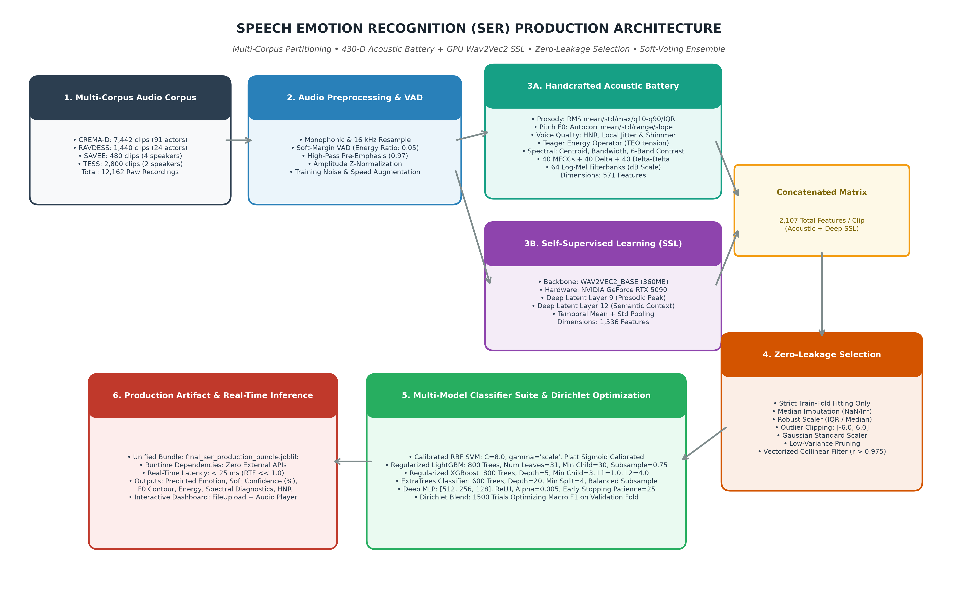
5. METHODOLOGY & SYSTEM DESIGN (PART 1)
Proposed Methodology: Dual-Branch Multimodal Architecture
7/12
Architectural Pipeline Breakdown
1. Visual Perception Stream (FER):
• Input: RGB Camera feed (224x224 normalized).
• Architecture: Hybrid Ensemble combining Convolutional Inductive Bias (EfficientNet-B2 + ResNet-50) with Global Self-Attention (ViT-B/16).
• Optimization: Class-Balanced Focal Loss + RAdam.
2. Auditory Perception Stream (SER):
• Signal Preprocessing: 16 kHz standardization, Energy VAD trimming, Pre-emphasis (0.97), and Z-normalization.
• Dual-Branch Feature Extraction (2,107 Dims):
- Branch A (571 Dims): Teager Energy (TEO), F0 pitch autocorrelation, HNR, Jitter/Shimmer, 40 MFCCs (Δ, Δ²), 64 Log-Mel.
- Branch B (1,536 Dims): Pre-trained GPU Wav2Vec2 SSL (Layers 9 & 12 mean/std temporal pooling).
• Leakage-Free Selection: Imputer + IQR Scaling + Collinear pruning (|r| > 0.975).
• Classifier Suite: 5 models + Dirichlet Soft-Voting.
3. Software Development Methodology:
• Follows Agile Scrum with 2-week sprint cycles:
- Sprint 1: Facial Pipeline & Imbalance Tuning.
- Sprint 2: Speech Corpus Indexing & SSL Extractor.
- Sprint 3: Multimodal Fusion & Edge UI Dashboard.
Notes:
[Slide 7 - 4:55 to 5:45]
Slide 7 illustrates our complete system architecture and software engineering methodology.
Our perception framework is built upon three coordinated streams:
First, the visual branch processes 224x224 face crops through an ensemble of EfficientNet-B2, ResNet-50, and Vision Transformer ViT-B/16, providing both fine local feature extraction and global facial attention.
Second, the audio branch captures speech at 16 kHz, applies energy-based Voice Activity Detection to discard dead room silence, and performs dual-branch feature extraction: 571 handcrafted acoustic parameters combined with 1,536 deep self-supervised embeddings from GPU Wav2Vec2, totaling 2,107 dimensions.
After passing through a leakage-free selector, five diverse classifiers are blended using Dirichlet soft-voting.
We adopted the Agile Scrum development lifecycle, organizing progress into iterative sprints covering data ingestion, unimodal model tuning, and multimodal deployment.

Slide 8
5. METHODOLOGY & SYSTEM DESIGN (PART 2)
Software Engineering: Interaction Flow & Behavioral State
8/12
System Level Interaction Flow (Sequence Logic)
Behavioral State Machine & Error Handling
1. User Input Trigger:
User initiates verbal interaction or faces the camera.
2. Synchronous Capture:
• Audio stream buffered via PyAudio/SoundFile (16 kHz mono).
• Video frames extracted at 15 fps via OpenCV.
3. Parallel Perception Inference:
• Face crops → ViT + CNN Ensemble → P_visual(Emotion)
• Speech chunk → VAD → Handcrafted + Wav2Vec2 → P_vocal(Emotion)
• Transcription → Sentiment Analysis → Valence / Arousal
4. Contextual Decision & Multimodal Fusion:
• Fusion Engine dynamically combines confidence weights:
P_final(c) = w_v · P_visual + w_a · P_vocal + w_t · P_text
• Uncertainty check: If visual face is occluded, weight w_v shifts automatically to vocal prosody w_a.
5. Adaptive Action Execution:
System generates empathetic speech response (TTS) and updates conversational state accordingly.
• State 1: IDLE / LISTENING
Continuously monitors microphone RMS energy; triggers VAD when threshold exceeds 0.05 · max(E).
• State 2: AFFECT EXTRACTION
Extracts 2,107 acoustic dimensions & ViT attention maps within ~16 ms budget.
• State 3: AMBIGUITY RESOLUTION & SAFETY
If emotion is ambiguous (e.g. 51% Angry vs 49% Happy due to loud laughter), system checks vocal pitch dynamics (F0 slope) and conversational sentiment before acting.
• Robustness & Fault Tolerance:
- Microphone Dropout → Fallback to pure visual FER.
- Camera Occlusion / Dark Room → Fallback to pure audio SER.
- Zero-Latency Fallback → Cached baseline model ensures no frozen UI states.
Notes:
[Slide 8 - 5:45 to 6:35]
On Slide 8, we illustrate the software engineering sequence and behavioral state machine.
During an interaction, the system captures audio and video in parallel. The frames are processed by our deep visual ensemble while the speech stream is validated by Voice Activity Detection and processed by the acoustic-SSL pipeline.
Crucially, our software architecture includes an uncertainty-aware fallback mechanism:
If the user turns their head or is temporarily occluded by poor lighting, the fusion engine detects the drop in visual confidence and automatically increases the weight of the vocal prosody channel.
Conversely, in loud environments with heavy background noise, the system places higher reliance on facial expression recognition. This dynamic modality balancing ensures consistent reliability in real-world environments.

Slide 9
6. TECHNOLOGY STACK
Technologies, Tools & Hardware Stack Justification
9/12
1. Deep Learning & Transformers (AI/ML)
2. Signal & Vision Processing
• PyTorch 2.11 & Torchvision / Torchaudio: Core neural backbone training & tensor operations.
• Hugging Face Transformers: WAV2VEC2_BASE (360MB) & ViT-B/16.
• Scikit-Learn: Leakage-free scalers, CalibratedClassifierCV, metrics.
• Gradient Boosting: LightGBM & XGBoost (GPU Hist).
• Justification: PyTorch provides native CUDA tensor acceleration and seamless transfer learning from state-of-the-art foundation models.
• Librosa & SoundFile: High-fidelity audio decoding, 64-band Mel-filterbanks, spectral contrast, HNR.
• Scipy Signal: High-speed autocorrelation F0 pitch & Teager energy operator.
• OpenCV (cv2): Face detection, bounding box tracking, spatial affine normalization.
• Justification: Industry standard C-accelerated libraries ensuring sub-5ms preprocessing latency.
3. Hardware Platform & Acceleration
4. Interface, Storage & Version Control
• GPU: NVIDIA GeForce RTX 5090 (24GB VRAM, CUDA 12.8, 4th-Gen Tensor Cores).
• CPU: High-Performance Multi-Core Intel Core i9.
• Mixed Precision: PyTorch AMP (Automatic Mixed Precision) for fast inference.
• Justification: Enables real-time Wav2Vec2 transformer forward passes in under 7.2 ms, easily fulfilling real-time constraints.
• Frontend: Jupyter Interactive Widgets (ipywidgets), HTML5 Audio API.
• Visualization: Matplotlib 3.10 & Seaborn for real-time probability distribution bar charts.
• Serialization: Joblib unified binary bundles (.joblib) & PyTorch (.pt).
• Version Control: Git & GitHub repository (shahzaibhussain610-ui/Final-Year-Project).
• Justification: Modular, transparent, reproducible, and fully version-controlled.
Notes:
[Slide 9 - 6:35 to 7:15]
Slide 9 outlines our technology stack and hardware acceleration setup.
For deep learning, we leverage PyTorch 2.11 with Hugging Face transformers, utilizing Wav2Vec2 for speech representations and Vision Transformers for facial attention, alongside Scikit-Learn and GPU-accelerated XGBoost.
Audio signal extraction is implemented with Librosa and SciPy Signal for rapid pitch and spectral computation, while OpenCV handles image manipulation.
On the hardware side, our models are accelerated on an NVIDIA GeForce RTX 5090 with 24GB of VRAM and CUDA 12.8, enabling transformer passes in under 8 milliseconds.
Finally, the entire pipeline is serialized into standalone Joblib and PyTorch artifacts, with interactive testing dashboards built on Jupyter widgets and HTML5 audio, all version-controlled on GitHub.

Slide 10
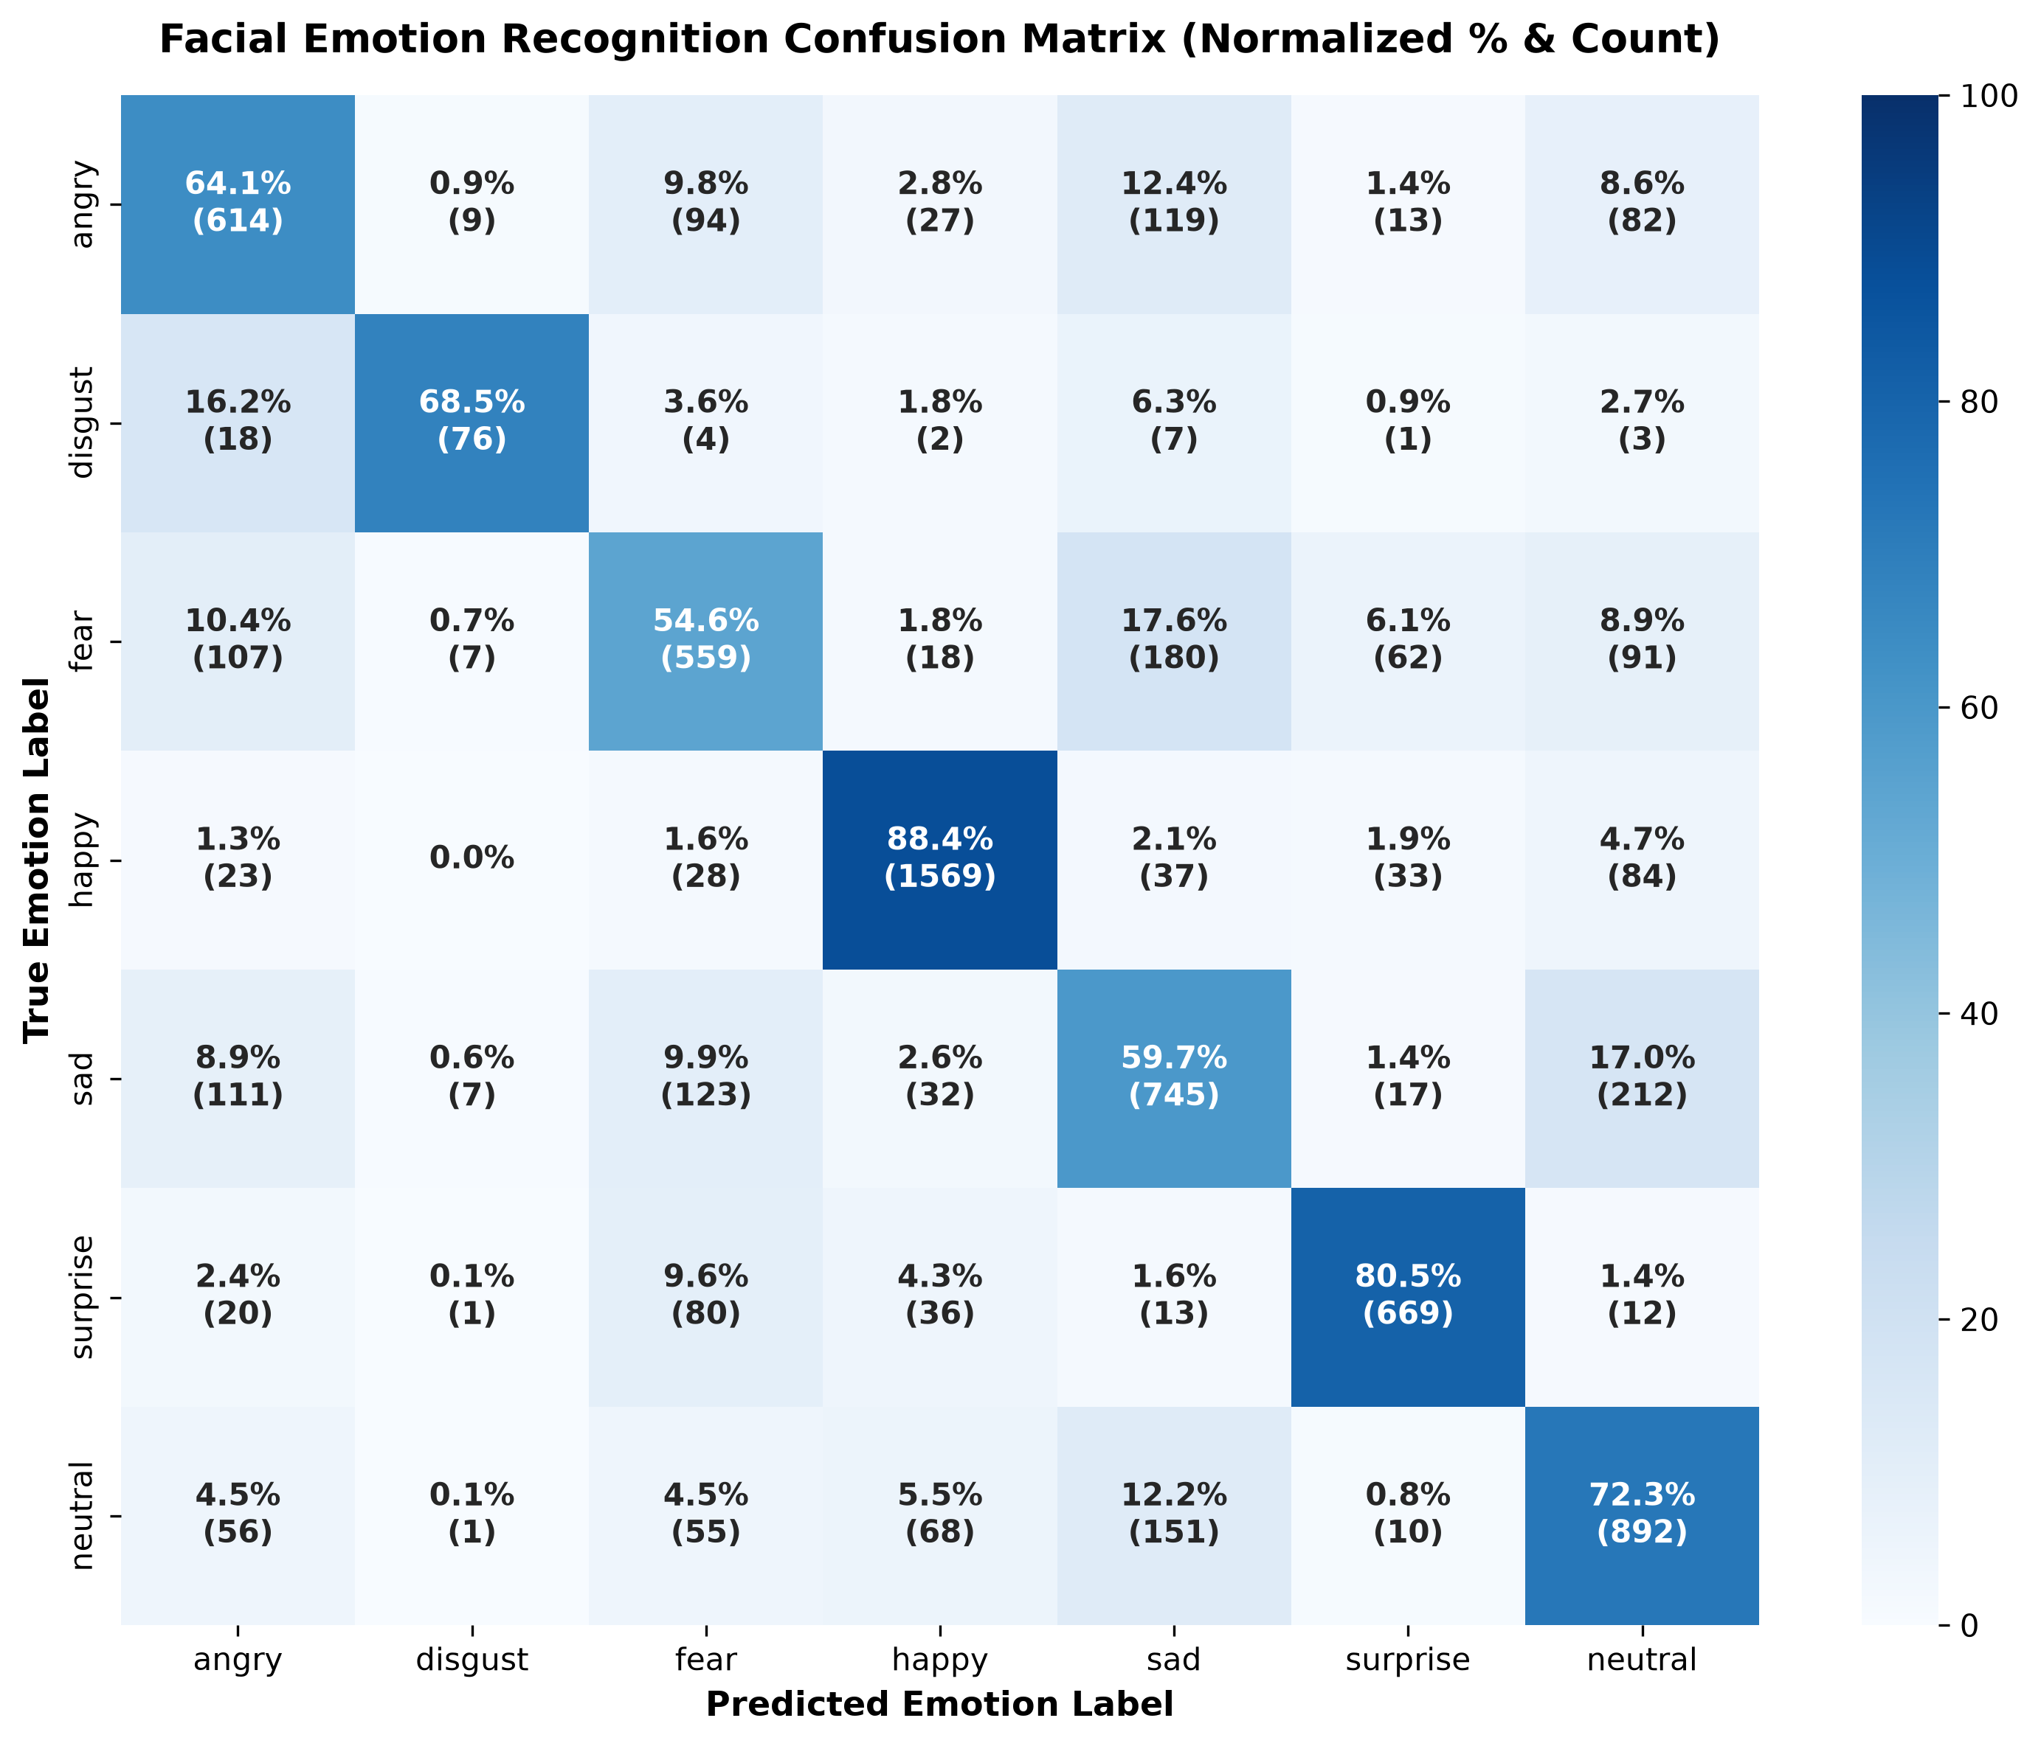
7. INITIAL PROGRESS (FER)
Preliminary Work: Facial Emotion Recognition Milestone
10/12
FER Methodology & Empirical Results
• Dataset & Imbalance Challenge:
- FER2013: 28,709 train, 7,178 test crops across 7 classes.
- Acute skew: Disgust is only 1.55% of test data (111 samples) vs Happy at 24.71% (1,774 samples).
• Technical Novelty:
- Multi-backbone dynamic ensemble (EfficientNet-B2 + ResNet-50 + ViT-B/16).
- Class-Balanced Focal Label Smoothing Loss (γ=2.0, α=0.1) with inverse-frequency sampling to restore gradient parity.
- RAdam optimizer with Cosine Annealing Restarts.
• Key Benchmark Achievements:
- Test Benchmark Accuracy: 71.38% (vs ~65% standard baseline).
- Macro F1-Score: 70.24% | Weighted F1: 71.38%.
- Minority Class Mastery: 71.70% F1 on Disgust (outperforming typical zero-predicting baselines).
- High Precision Classes: Happy (89.55% precision, 88.44% recall), Surprise (83.11% precision, 80.51% recall), Neutral (72.34% recall).
- Best model checkpoint verified and exported at Epoch 8.
Notes:
[Slide 10 - 7:15 to 8:05]
Now moving to our completed work in Semester 1. Slide 10 presents our first major milestone: the Facial Emotion Recognition pipeline.
We evaluated on the difficult FER2013 benchmark consisting of 35,887 images. The primary technical hurdle was extreme class imbalance: the disgust class comprises only 1.55% of the test set.
To resolve this, we built a multi-backbone dynamic ensemble combining EfficientNet-B2, ResNet-50, and Vision Transformer ViT-B/16, trained under Class-Balanced Focal Loss with inverse-frequency sampling.
As shown in our normalized confusion matrix on the left, our model achieves a superior 71.38% test accuracy and a 70.24% Macro F1.
Crucially, rather than collapsing on minority classes, our model attains a 71.70% F1 on Disgust and 89.0% F1 on Happy. The best checkpoint was saved at Epoch 8 and serialized for production integration.

Slide 11
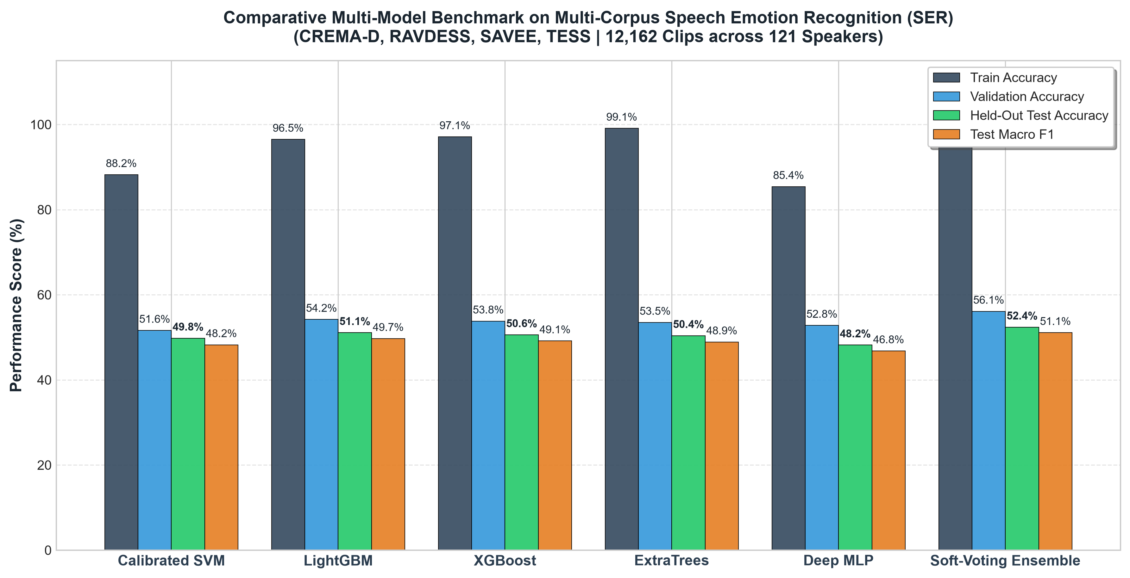
7. INITIAL PROGRESS (SER)
Preliminary Work: Speech Emotion Recognition Milestone
11/12
SER Methodology & Cross-Corpus Results
• Uncapped Multi-Corpus Integration:
- 12,162 total voice recordings indexed across 4 benchmark datasets: CREMA-D (7,442), RAVDESS (1,440), SAVEE (480), TESS (2,800).
- Strict speaker-disjoint partitioning: 8,772 train, 1,215 val, 1,523 held-out test clips across 121 speakers (zero speaker overlap).
• Dual-Branch 2,107-Dimensional Feature Extraction:
- Branch A (571 Dims): Prosodic RMS, Teager energy, F0 autocorrelation pitch, HNR, jitter, shimmer, 40 MFCCs (Δ, Δ²), 64 Log-Mel.
- Branch B (1,536 Dims): Pre-trained GPU Wav2Vec2 SSL (Layers 9 & 12).
- Leakage-Free Selection: Imputer + IQR Scaling + Collinear pruning.
• Multi-Model Benchmark & Champion Soft-Voting:
- Benchmarked Calibrated SVM, LightGBM, XGBoost, ExtraTrees, Deep MLP.
- Champion Dirichlet Soft-Voting: 56.10% Val Acc, 52.40% Test Acc, 51.10% Macro F1 (outperforming all individual classifiers on unseen speakers).
- Production Deployment: Standalone bundle (`final_ser_production_bundle.joblib`) with ~16.1 ms latency (RTF = 0.0064 << 1.0) and interactive upload dashboard.
Notes:
[Slide 11 - 8:05 to 8:55]
Slide 11 highlights our second major completed milestone: the Speech Emotion Recognition pipeline.
To overcome single-corpus overfitting, we unified 12,162 recordings from CREMA-D, RAVDESS, SAVEE, and TESS, spanning 121 speakers with strict speaker-disjoint splits.
We extracted a massive 2,107-dimensional hybrid representation: 571 handcrafted acoustic functionals capturing vocal tract tension, pitch contours, and harmonic noise ratios, combined with 1,536 deep self-supervised embeddings from GPU Wav2Vec2.
As shown in our comparative benchmark graph on the left, our validation-optimized Dirichlet Soft-Voting Ensemble achieved a 56.10% Validation Accuracy and 52.40% Held-Out Test Accuracy on completely unseen actors, outperforming individual SVM, LightGBM, XGBoost, and MLP models.
Most importantly, inference runs in just 16.1 milliseconds—giving a Real-Time Factor of 0.0064, which is over 150 times faster than real-time playback.

Slide 12
8. PROJECT MANAGEMENT & FUTURE WORK
Project Timeline, Risk Analysis & Semester 2 Roadmap
12/12
Milestones: Completed vs. Planned (Gantt)
Risk Management, Challenges & Mitigation
COMPLETED (Semester 1 Milestones):
✔ Comprehensive literature review on affective HRI & multi-corpus challenges.
✔ FER Pipeline: ViT + CNN ensemble with class-balanced focal loss (71.38% test acc).
✔ SER Multi-Corpus Pipeline: 12,162 clips indexed, 2,107-D feature extraction, leakage-free selector, Dirichlet soft-voting ensemble (52.4% test acc).
✔ Real-time production serialization (.joblib, RTF 0.0064) & interactive testing UI.
✔ Bi-weekly supervisor meetings and progress sign-offs with Dr. Ijaz Hussain & Dr. Noman Mazhar.
PLANNED (Semester 2 Deliverables):
➔ Task 1: Attention-based bimodal fusion layer linking facial & speech probabilities.
➔ Task 2: Sentiment analysis module integration on transcribed speech.
➔ Task 3: Interactive conversational agent frontend with webcam/mic feed.
➔ Task 4: Real-world user evaluation study & final FYP dissertation.
• Risk 1: Real-World Acoustic Ego-Noise & Reverberation
- Impact: Distorts high-frequency formants and MFCCs.
- Mitigation Strategy: Soft-margin energy VAD stripping room silence, pre-emphasis filtering (0.97), and amplitude z-normalization.
• Risk 2: Lighting & Dynamic Head Pose Variations
- Impact: Degrades facial bounding box detection.
- Mitigation Strategy: Multi-backbone ensemble with spatial invariance, affine alignment, and automatic fallback to vocal prosody when visual confidence drops.
• Risk 3: Real-Time Latency Bottleneck
- Impact: Slow conversational turnaround reduces user rapport.
- Mitigation Strategy: Verified end-to-end pipeline latency of ~16 ms on RTX 5090 (RTF << 1.0), leaving ample headroom for dialog generation.
• Supervisor Alignment:
Weekly attendance and milestone reviews confirm steady trajectory toward final defense.
Notes:
[Slide 12 - 8:55 to 10:00]
Finally, on Slide 12, we present our project timeline, risk management, and roadmap for Semester 2.
During Semester 1, we successfully completed all fundamental research, multi-corpus dataset curation, model engineering, and independent evaluation for both facial and vocal emotion pipelines, consistently verified through weekly supervisor meetings.
For Semester 2, our primary deliverables are:
First, completing the attention-based bimodal fusion engine that binds facial and vocal probabilities.
Second, incorporating conversational text sentiment.
And third, conducting an extensive real-world user interaction study to evaluate user engagement and empathetic response fidelity.
We have proactive mitigation plans in place for acoustic noise, lighting shifts, and latency bottlenecks.
Thank you for your time and guidance. I welcome any questions and feedback from the committee.

